Slide 1
Introduction to Software Engineering
CSSE3113

Slide 2
Questions from a Customer
Do you understand my problem and needs?
Can you design a system to solve my problems or satisfy my needs?
How long will it take to develop the system?
How much will it cost to develop the system?

Slide 3
Project Schedule
Describes the software-development cycle for a particular project by
enumerating the phases or stages of the project
breaking each phase into discrete tasks or activities to be completed
Portrays the interactions among the activities and estimates the times that each task or activity will take

Slide 4
Project Schedule (Contd.)
Understanding customer’s needs by listing all project deliverables
Documents
Demonstrations of function
Demonstrations of subsystems
Demonstrations of accuracy
Demonstrations of reliability, performance or security
Determining milestones and activities to produce the deliverables

Slide 5
Project Schedule (Contd.)
Activity: takes place over a period of time
Milestone: completion of an activity -- a particular point in time
Precursor: event or set of events that must occur in order for an activity to start
Duration: length of time needed to complete an activity
Due date: date by which an activity must be completed

Slide 6
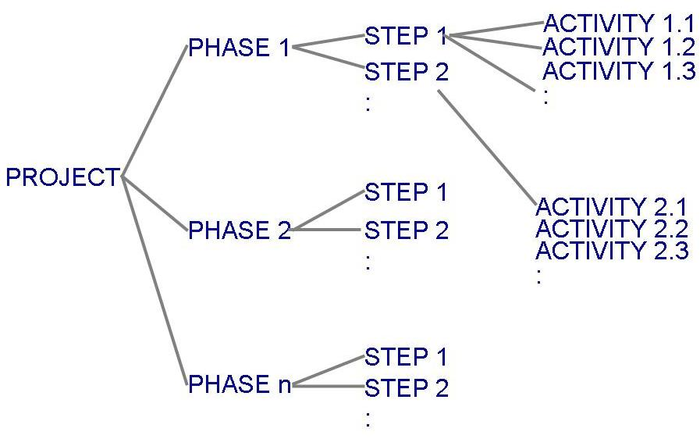
Project Schedule (Contd.)
Project development can be separated into a succession of phases which are composed of steps, which are composed of activities
Work Breakdown Structure

Slide 7
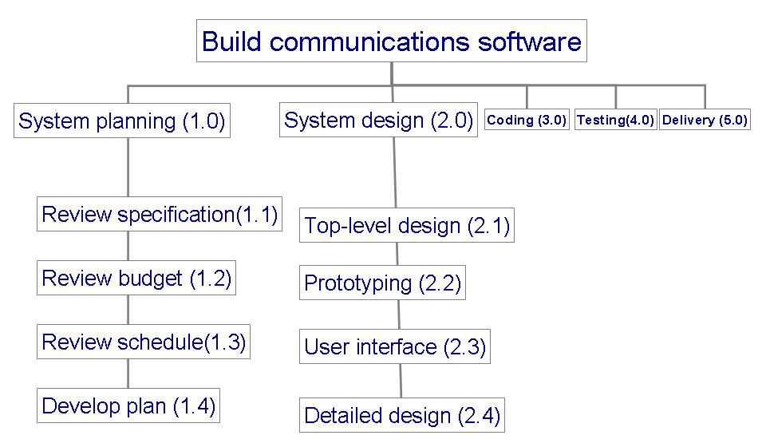
Work breakDown Structure (WBS)
Example: to track progress of building a communication software

Slide 8
Work Breakdown Structure (WBS) Phases, Steps, and Activities in Building a House
Table 3.1 shows the phases, steps and activities to build a house
landscaping phase
building the house phase

Slide 9
Milestones
Table 3.2 lists milestones for building the house phase

Slide 10
WBS and Activity Graphs
Work breakdown structure depicts the project as a set of discrete pieces of work
Activity graphs depict the dependencies among activities
Nodes: project milestones
Lines: activities involved

Slide 11
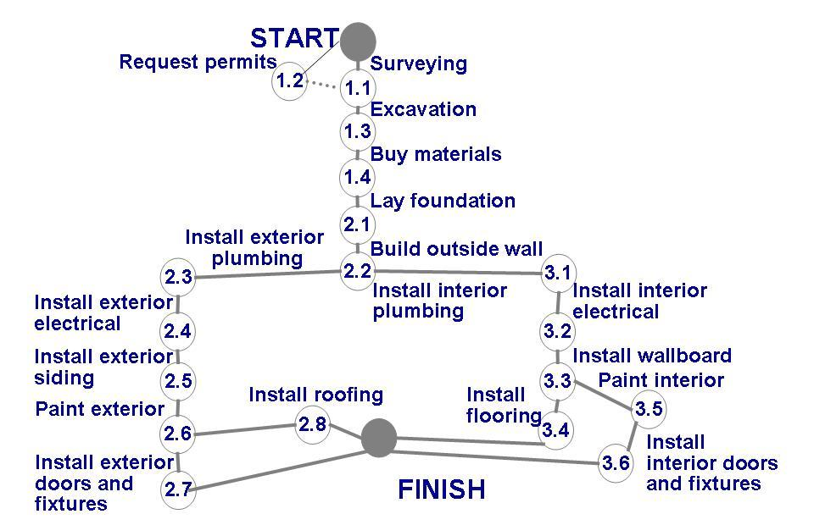
Identify precursor events
Activity graph for building a house
2.7, 2.8, 3.4, 3.6?
Does it tell us:
1.1 and 1.2 are precursor to Excavation activity
About completion of the project?
Duration of the project?
How can we modify the graph to estimate completion?
Mention duration of each activity?

Slide 12
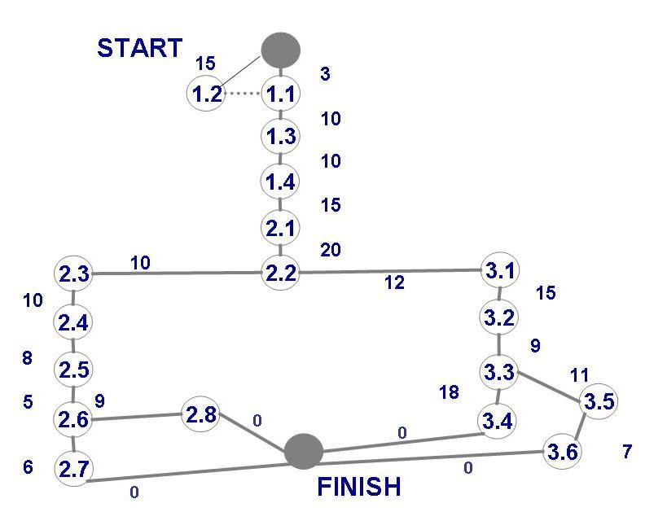
Estimating Completion
Adding estimated time in activity graph of each activity to be completed tells us more about the project's schedule

Slide 13
Estimating Completion Critical Path Method
Minimum amount of time required to complete a project
Reveals those activities that are most critical to completing the project on time
Real time (actual time): estimated amount of time required for the activity to be completed
Available time: amount of time available in the schedule for the activity's completion
Slack time: the difference between the available time and the real time for that activity

Slide 14
Critical Path Method (CPM) (The longest path or the path with zero (0) slack time is the critical path).
You can use the following steps to find a critical path in a network diagram:
Draw the network diagram.
Identify all paths in the network diagram.
Find the duration of each path.
The path with the largest duration is the critical path.
We can calculate 04 stats :
Early Start
Late Start
Early Finish
Late Finish

Slide 15
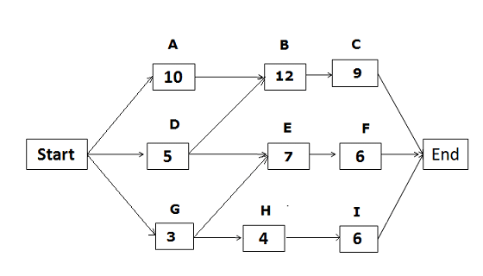
Critical Path Method (CPM) 1. Draw the network diagram.
Consider a software development project that consists of the following activities:
Activity A….10 days essential before any other work can begin
Activity B….12 days must follow A and D and be complete before C starts
Activity C….9 days must follow B and be complete by the end of the project
Activity D….5 days essential before any other work can begin
Activity E….7 days must follow D and G and be complete before F starts
Activity F….6 days must follow E and be complete by the end of the project
Activity G….3 days essential before any other work can begin
Activity H….4 days must follow G and be complete before I starts
Activity I….6 days must follow H and be complete by the end of the project
Activity | Duration | Predecessor(s)
A | 10 days | -
B | 12 days | A,D
C | 9 days | B
D | 5 days | -
E | 7 days | D,G
F | 6 days | E
G | 3 days | -
H | 4 days | G
I | 6 days | H
OR

Slide 16
Critical Path Method (CPM) 2.Identify all paths in the network diagram. 3.Find the duration of each path.
Early Start | Duration | Early Finish
Activity
Late Start | Float | Late Finish
Applying Forward Pass
 | 10
A
 | 12
B
 | 9
C
0
10
10
22
22
31
EF = ES + D
ES = Highest Time
 | 5
D
 | 7
E
 | 6
F
0
5
5
12
12
18
31
Start
END
 | 3
G
 | 4
H
 | 6
I
0
3
3
7
7
13

Slide 17
Critical Path Method (CPM) 2.Identify all paths in the network diagram. 3.Find the duration of each path.
Early Start | Duration | Early Finish
Activity
Late Start | Float | Late Finish
Applying Backward Pass
 | 10
A
 | 12
B
 | 9
C
0
10
10
22
22
31
EF = ES + D
ES = Highest Time
0
10
10
22
22
31
LS = LF - D
LF = Minimum Time
 | 5
D
 | 7
E
 | 6
F
0
5
5
12
12
18
31
Start
END
5
10
18
25
25
31
 | 3
G
 | 4
H
 | 6
I
0
3
3
7
7
13
15
18
21
25
25
31

Slide 18
Critical Path Method (CPM) 2.Identify all paths in the network diagram. 3.Find the duration of each path.
Early Start | Duration | Early Finish
Activity
Late Start | Float | Late Finish
Calculating Slack time OR Float
 | 10
A
 | 12
B
 | 9
C
0
10
10
22
22
31
EF = ES + D
ES = Highest Time
0
0
10
10
0
22
22
0
31
LS = LF - D
LF = Minimum Time
 | 5
D
 | 7
E
 | 6
F
0
5
5
12
12
18
31
Slack time (float) = LS – ES OR LF – EF
Start
END
Slack time (float) = 0 is critical activity
5
5
10
18
13
25
25
13
31
 | 3
G
 | 4
H
 | 6
I
0
3
3
7
7
13
15
15
18
21
18
25
25
18
31

Slide 19
Critical Path Method (CPM) 2.Identify all paths in the network diagram. 3.Find the duration of each path.
Early Start | Duration | Early Finish
Activity
Late Start | Float | Late Finish
Calculating Critical Path
 | 10
A
 | 12
B
 | 9
C
0
10
10
22
22
31
EF = ES + D
ES = Highest Time
0
0
10
10
0
22
22
0
31
LS = LF - D
LF = Minimum Time
 | 5
D
 | 7
E
 | 6
F
0
5
5
12
12
18
31
Slack time (float) = LS – ES OR LF – EF
Start
END
Slack time (float) = 0 is critical activity
5
5
10
18
13
25
25
13
31
 | 3
G
 | 4
H
 | 6
I
0
3
3
7
7
13
Critical Path is A-B-C
15
15
18
21
18
25
25
18
31
4. The longest path or the path with zero (0) slack time is the critical path.

Slide 20
Critical Path Method (CPM) Table Representation
 | 10
A
 | 12
B
 | 9
C
0
10
10
22
22
31
0
0
10
10
0
22
22
0
31
 | 5
D
 | 7
E
 | 6
F
0
5
5
12
12
18
31
Start
END
5
5
10
18
13
25
25
13
31
 | 3
G
 | 4
H
 | 6
I
0
3
3
7
7
13
15
15
18
21
18
25
25
18
31

Slide 21
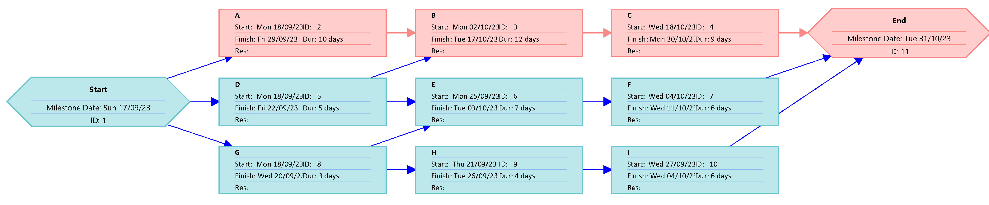
Critical Path Method (CPM) MS Project Representation (Network graph)

Slide 22
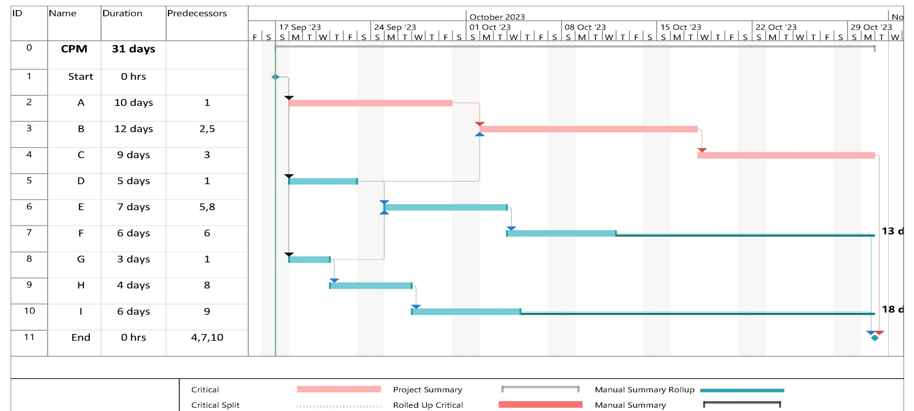
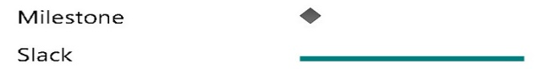

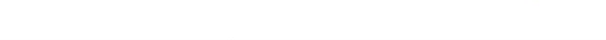
Critical Path Method (CPM) MS Project Representation (Gantt Chart)
Gantt Chart:
Helps understand which activities can be performed concurrently.
Activities are shown in parallel

Slide 23
Special THANK FOR THE MATERIALS
Mr. Haroon Abdul Waheed
Pfleeger’s Book slides from UCF
Software Fundamentals

